Slide 1

Introduction to Databases and ORMs
SQL, Data Relationships, Django Integration
SoftUni
SoftUni Trainers Team

Slide 2
Databases and ORMs
Databases
SQL
Sqlite and Basic CRUD
ORM and Models
Data Relations

Slide 3
Have a Question?
sli.do #DjangoWeb

Slide 4

Data Management
Why Do We Need Databases?

Slide 5
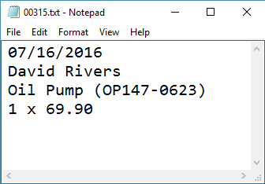
Storage vs. Management
Conventional Data Storage
Data
SALES RECEIPT
Date: 07/16/2016
Order#: [00315]
Customer: David Rivers
Product: Oil Pump
S/N: OP147-0623
Unit Price: 69.90
Qty: 1
Total: 69.90
Representation

Slide 6
Storage vs. Management
We can group related pieces of data into separate columns

Slide 7
Storage vs. Management
Storing data is not the primary reason to use a database
Flat storage eventually runs into issues with:
Size
Ease of updating
Accuracy
Security
Redundancy

Slide 8
Databases and RDBMS
A database is an organized collection of information
It imposes rules on the contained data
Relational storage first proposed by Edgar Codd in 1970
A Relational Data Base Management System provides tools for managing the database
It parses requests from the user and takes the appropriate action
The user doesn't have direct access to the stored data
There are alternative approaches like NoSQL Databases

Slide 9


Database Engines
Client Server Model

Slide 10





Database Engine Flow
SQL Servers uses the Client-Server Model
Clients
Query
Engine
Access
Database
Data
Data

Slide 11


Client-Server Model
CLIENTS
TCP/IP
DATABASE
Notes:
Relational Database Management Systems (RDBMS) are based on a Client-Server model. Normally, clients communicate with the database over (Transmission Control Protocol/Internet Protocol) TCP/IP protocol. TCP/IP is a basic communication language over the internet. It has two layers: - TCP – it is assembling the communication into smaller packages transferred through the internet and received by another TCP which reassembles the packages into the original communication. - IP – responsible for the addresses in order communication to get to the right destination
Here are some of the default ports that databases are using: - MySQL - 3306 - SQL Server - 1433 - Oracle - 1521 Clients – it begins the communication with the server. SQL Server and MySQL have different clients. SQL Server uses SQL Server Management Studio(SSMS). MySQL has many: HeidiSQL, MySQL Workbench etc.

Slide 12
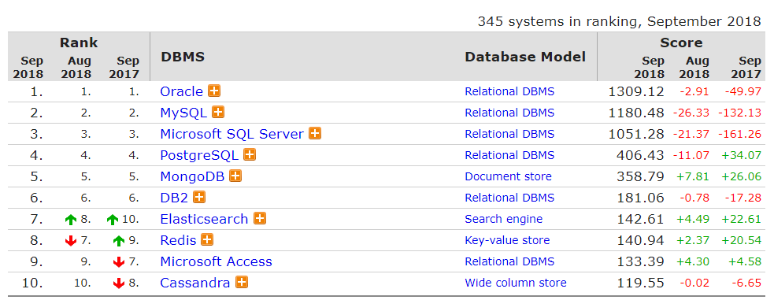
Top Database Engines
Source: http://db-engines.com/en/ranking

Slide 13

Structured Query Language
Query Components

Slide 14
Structured Query Language
Programming language designed for managing data in a relational database
Developed at IBM in the early 1970s
To communicate with the Engine we use SQL

Slide 15
Structured Query Language
Subdivided into several language elements
Queries
Clauses
Expressions
Statements
Insert Clause
Expression
INSERT employees (name)
VALUES "Guido " || "Van Rossum"
Statement

Slide 16
Structured Query Language
Logically divided in four sections
Data Definition – describe the structure of our data
Data Manipulation – store and retrieve data
Data Control – define who can access the data
Transaction Control – bundle operations and allow rollback

Slide 17

Sqlite3
Data Types, Installation, Basic Usage

Slide 18
Sqlite3
Sqlite3 is a light and easy to install DBMS
Suitable for when you need quick and small databases
The database is a single file, no magic
No special setup, it just works
If you need something scalable, consider other DBMSs
Django is using it by default
When in doubt, read the docs

Slide 19
Sqlite3: Data Types
Numeric
INTEGER – different sizes
FLOAT, DOUBLE, DECIMAL – representing real numbers
Strings
VARCHAR(MAX_SIZE) – variable size string
TEXT – text data block
Datetime
DATETIME

Slide 20
Installation
Windows: Download this and unzip it somewhere in your PATH
Linux/MacOS:
There are precompiled binaries @ https://www.sqlite.org/download.html
Or alternatively you can use your system's package manager
e.g. Ubuntu (Debian based):
https://www.sqlite.org/2018/sqlite-tools-win32-x86-3240000.zip
sudo apt-get install sqlite3 libsqlite3-dev

Slide 21
Sqlite3: Basic Usage
Opening a database:
Getting help:
> sqlite3 [optional db file]
sqlite> # This is the sqlite prompt
sqlite> .quit
> # back to the shell
sqlite> .help

Slide 22
Sqlite3: Other Useful Commands
List tables in file:
Show how tables were created:
Read SQL Statements from file:
Change to another database:
sqlite> .tables
sqlite> .schema [optional table name]
sqlite> .read <filename>
sqlite> .open <db filename>

Slide 23

CRUD
Create, Retrieve, Update, Delete

Slide 24
CRUD
Table Creation:
Table Name
> sqlite3 employees.db
sqlite> CREATE TABLE employees (
...> Id INTEGER NOT NULL UNIQUE,
...> Email VARCHAR(255),
...> FirstName VARCHAR(255),
...> LastName VARCHAR(255)
...> );
sqlite> .tables
employees
sqlite> .quit
Constraints
Column Type
Column Name

Slide 25
CRUD
Retrieval of data:
You can limit the columns and number of records retrieved:
> sqlite3 employees.db
sqlite> SELECT * FROM employees;
sqlite> SELECT FirstName, LastName
...> FROM employees
...> LIMIT 5;

Slide 26
CRUD
Creation of Data:
> sqlite3 employees.db
sqlite> INSERT INTO employees (Id, FirstName, LastName)
...> (0, "Guido", "Van Rossum");
sqlite> .nullvalue None
sqlite> SELECT * FROM employees;
Id Email FirstName LastName
---------- ---------- ---------- ----------
0 None Guido Van Rossum
sqlite> .quit
Effect from .nullvalue

Slide 27
CRUD
Updating a Table Record:
> sqlite3 employees.db
sqlite> UPDATE employees SET Email = "rossum@johndoe.com"
...> WHERE FirstName = 'Guido' AND LastName = 'Rossum';
sqlite> SELECT * FROM employees;
Id Email FirstName LastName ---------- ------------------------- ---------- ---------- 0 vanrossum@nonexistant.org Guido Van Rossum
sqlite> .quit

Slide 28
CRUD
Deletion of Table Records:
Deletion of Tables:
> sqlite3 employees.db
sqlite> DELETE FROM employees WHERE FirstName = 'Guido';
sqlite> SELECT * FROM employees; # No output
sqlite> DROP TABLE employees;
sqlite> .tables # No output
sqlite> .quit

Slide 29

Data Relationships

Slide 30
Why Split Related Data?
Empty records
First | Last | Registered | Email
David | Rivers | 05/02/2016 | drivers@mail.cx
Sarah | Thorne | 07/17/2016 | sarah@mail.cx
Michael | Walters | 11/23/2015 | walters_michael@mail.cx
Email2
NULL
NULL
david@homedomain.cx
Redundant Information
OrderID | Date | Customer | Product | S/N | Price
00315 | 07/16/2016 | David Rivers | Oil Pump | OP147-0623 | 69.90
00315 | 07/16/2016 | David Rivers | Accessory Belt | AB544-1648 | 149.99
00316 | 07/17/2016 | Sarah Thorne | Wiper Fluid | WF000-0001 | 99.90
00317 | 07/18/2016 | Michael Walters | Oil Pump | OP147-0623 | 69.90

Slide 31
Related Tables
We split the data and introduce relationships using shared values between the tables to avoid repeating information
The connection is established via Foreign Key in one table pointing to the Primary Key of another
UserID | First | Last | Registered
203 | David | Rivers | 05/02/2016
204 | Sarah | Thorne | 07/17/2016
205 | Michael | Walters | 11/23/2015
UserID | Email
203 | drivers@mail.cx
204 | sarah@mail.cx
205 | walters_michael@mail.cx
203 | david@homedomain.cx
Primary Key
Foreign Key

Slide 32
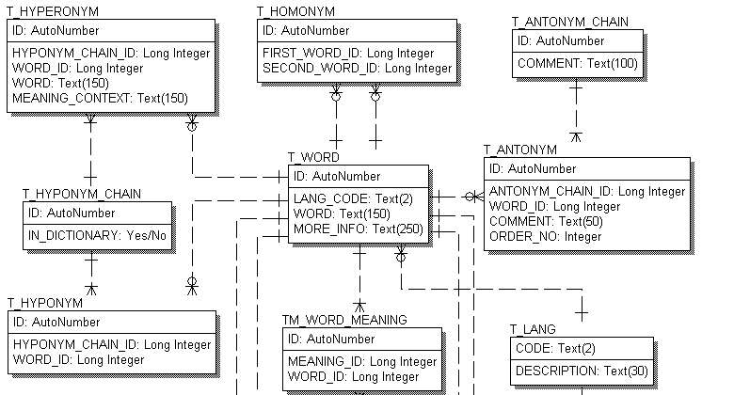
Entity-Relationship Diagrams (ERD)

Slide 33

Sqlite Through Python

Slide 34
Sqlite Through Python
There is a builtin module `sqlite3`
Basic Usage:
import sqlite3
create_table = 'create table test (id integer, txt varchar(50);'
with sqlite3.connect('example.db') as conn:
c = conn.cursor():
c.execute(create_table)
c.execute(<some insert statement as string>)
c.close()
conn.commit()

Slide 35
Passing Arguments To Queries
Obligatory xkcd comic
Passing arguments to queries:
Quote from the documentation of PostgreSQL Python library:
We need to escape special symbols use prepared statements
arguments = ("arg1", 42, "arg3)
c.execute('INSERT INTO <table> VALUES (?, ?, ?)', arguments)
c.commit()

Slide 36
Getting Data Back From Sqlite
There are several fetch methods belonging to the cursor object:
fetchone()
Retrieves one row which by default is a tuple of Python primitives, if the result set is Empty - None is returned
fetchmany(size=cursor.arraysize)
Retrieves `size` rows from the result set
cursor.arraysize is equal to 1 by default
fetchall()
Retrieves all of the remaining rows of the query result

Slide 37

Introduction to Django ORM

Slide 38
What is an ORM?
Object Relational Mapping (ORM) allows the user to manipulate databases through Python classes and objects
Provides an abstraction layer over DBMSs, meaning that if we change our DBMS, our app will most likely still work
Person(name='Adrian Holovaty').save()
INSERT INTO myapp_person VALUES (0, 'Holovaty')

Slide 39
ORMs: Advantages and Disadvantages
Advantages:
We write less code
Easier to maintain
Simplifies CRUD over complex relationships
Disadvantages:
Reduced performance
We gain convenience at the cost of flexibility

Slide 40
Models
An object who is managed by the ORM is called a Model
It contains the useful parts of the real-world entity that we are trying to model
Each attribute of the Model represents a database field
Every Model inherits from django.db.models.Model directly or indirectly
By inheriting from the base Model Django gives us an automagical API for making queries

Slide 41
Fields
Example Fields:
models.CharField(max_length)
models.TextField()
models.DateTimeField(auto_add=False)
models.EmailField()
…And many more

Slide 42
Example Model
models.py
from django.db import models
class Employee(django.db.models.Model):
name = models.CharField(max_length=20)
email = models.EmailField(null=True)
age = models.PositiveIntegerField(null=True)
created_at = models.DateTimeField(auto_now_add=True)

Slide 43
Set Up
We have to tell our project to track the models of our app
We do that by editing our project's settings.py file:
INSTALLED_APPS = [
…
'<app name>',
]

Slide 44
Set Up
Generating the SQL needed for the creation/update:
You can see the generated SQL by:
Applying the changes:
> python manage.py makemigrations
> python manage.py sqlmigrate <app name> <migration number>
> python manage.py migrate

Slide 45
Exploring the DB API
We can load a python interpreter with Django preloaded:
Storing model instances:
> python manage.py shell
>>> from my_app.models import Employee
>>> employee = Employee(name='Simon Willison')
>>> employee.save()

Slide 46
Exploring the DB API
Retrieval:
Updating:
Deletion:
>>> simon = Employee.objects.get(name='Simon Willisen')
>>> employees = Employee.objects.all() # Return a QuerySet
>>> simon.name = 'Simon Willison'
>>> simon.save()
>>> simon.delete()

Slide 47
Filtering and Ordering
Filtering: reference
Ordering:
Functions after `objects` can be chained one after another
>>> simons = Employee.objects.filter(name__startswith='Simon')
>>> this_year = Employee.objects.filter(created_at__year_gt=2017)
>>> adults = Employee.objects.filter(age__range=(18, 30))
>>> asc = Employee.objects.order_by('name')
>>> desc = Employee.objects.order_by('-name', 'created_at')

Slide 48
Relationships: Example Models
class Company(models.Model):
name = models.CharField(max_length=128)
class Employee(models.Model):
name = models.CharField(max_length=32)
company = models.ForeignKey(
Company,
on_delete=models.SET_NULL,
null=True
)

Slide 49
Relationships
The example defines a One-To-Many relationship
One Company can have Many Programmers
A Programmer can have only one company
The first positional argument specifies to which Model our Model relates
The on_delete argument specifies what should happen to Programmers when a Company is deleted
Possible values

Slide 50
Summary
SQL
Optimized and easy management of data
Models
Basic migrations
Relationships
Django DB API

Slide 51

License
This course (slides, examples, demos, videos, homework, etc.) is licensed under the "Creative Commons Attribution-NonCommercial-ShareAlike 4.0 International" license

Slide 53





Trainings @ Software University (SoftUni)
Software University – High-Quality Education, Profession and Job for Software Developers
softuni.bg
Software University Foundation
http://softuni.foundation/
Software University @ Facebook
facebook.com/SoftwareUniversity
Software University Forums
forum.softuni.bg

